Slide 1
Do Now 11.5.13

Slide 2
Innovations of Mesopotamia

Slide 3
Innovations | What is it? | So What?
Cuneiform
Plow
Irrigation
Calendar

Slide 4
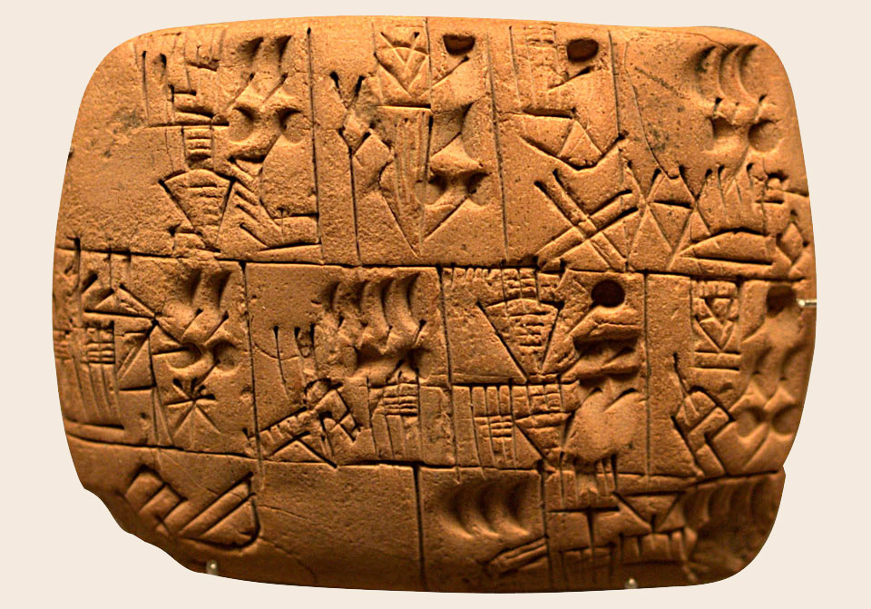
Cuneiform
The Sumerian writing system was developed around 3300 BCE
It is considered the first alphabet

Slide 5
The development of writing impacted all aspects of Sumerian life. Farmers could record which crops they grew each year and record plans for future planting. Merchants were able to keep detailed records of their transactions. Laws could be written down and standardized across large areas. Records of legal disputes and the resulting settlements could also be kept.

Slide 6
Innovations | What is it? | So What?
Cuneiform | A system of writing using wedge-shaped symbols | - Farmers wrote down what they planted - Laws written down - Merchants kept details of transactions - Land-owners kept details of transactions
Plow
Irrigation
Calendar

Slide 7
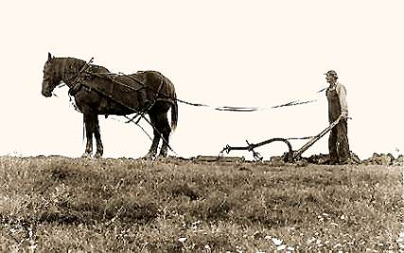
Plow

Slide 8
Innovations | What is it? | So What?
Cuneiform | A system of writing using wedge-shaped symbols | - Farmers wrote down what they planted - Laws written down - Merchants kept details of transactions - Land-owners kept details of transactions
Plow | A farming tool that breaks up the soil to make it easier to farm. | Farmers could work easier and create more food.
Irrigation
Calendar

Slide 9
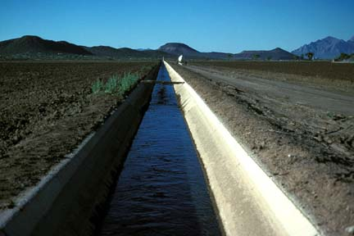
Irrigation Techniques

Slide 10
Innovations | What is it? | So What?
Cuneiform | A system of writing using wedge-shaped symbols | - Farmers wrote down what they planted - Laws written down - Merchants kept details of transactions - Land-owners kept details of transactions
Plow | A farming tool that breaks up the soil to make it easier to farm. | Farmers could work easier and create more food.
Irrigation | Controlling the flow of water | With this control, they could water plants when needed and stop the flow when there was too much.
Calendar

Slide 11
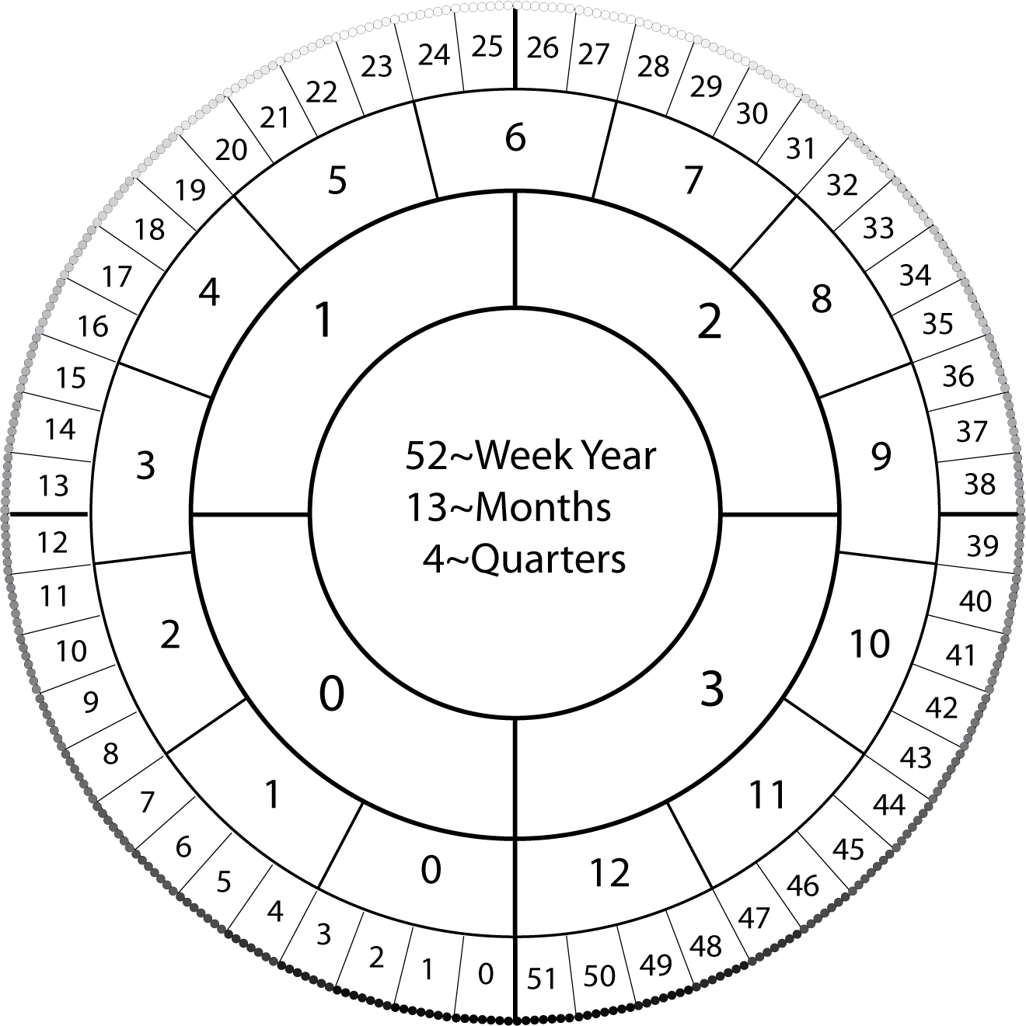
Calendars

Slide 12
Innovations | What is it? | So What?
Cuneiform | A system of writing using wedge-shaped symbols | - Farmers wrote down what they planted - Laws written down - Merchants kept details of transactions - Land-owners kept details of transactions
Plow | A farming tool that breaks up the soil to make it easier to farm. | Farmers could work easier and create more food.
Irrigation | Controlling the flow of water | With this control, they could water plants when needed and stop the flow when there was too much.
Calendar | A way to track the days of the year | They helped farmers know when to plant crops and grow more food

Slide 13
Choose one Mesopotamian innovation and write a paragraph telling how life would be different without it!

