Slide 1
DEAR

Slide 2
Do Now 11.14.13
For Ms. Ornat’s birthday (which is today…) she would like you to write what you have enjoyed most about this course.

Slide 3
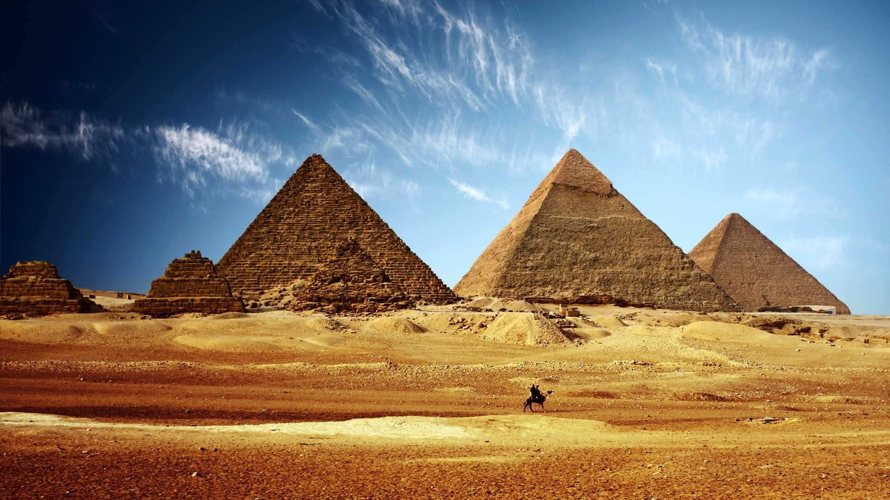
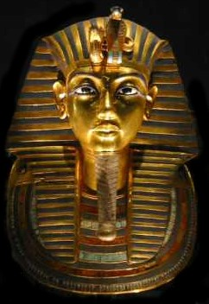
Introduction to Ancient Egypt

Slide 4
Geography of Egypt
The ancient Egyptians enjoyed many natural barriers. There were deserts to the east and west of the Nile River, and mountains to the south. This isolated the ancient Egyptians and allowed them to develop a truly distinctive culture.

Slide 5
Black Land vs. Red Land
The 'black land' was the fertile land on the banks of the Nile. The ancient Egyptians used this land for growing their crops. This was the only land in ancient Egypt that could be farmed because a layer of rich, black silt was deposited there every year after the Nile flooded.
The 'red land' was the barren desert that protected Egypt on two sides. These deserts separated ancient Egypt from neighboring countries and invading armies. They also provided the ancient Egyptians with a source for precious metals and semi-precious stones.

Slide 6
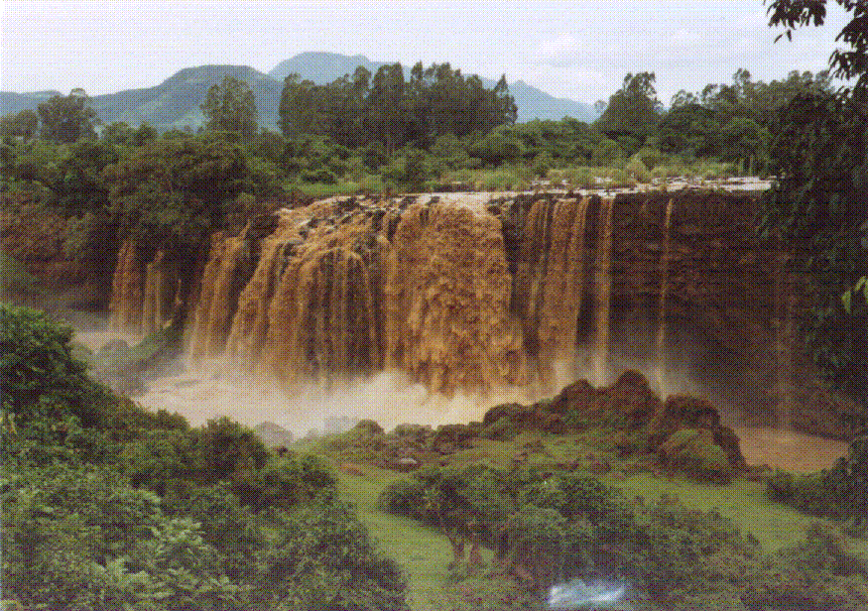
NILE RIVER VALLEY
Lifeline of Egypt is the Nile River.
Nile River supplies 85% of the country’s water.
The Nile River is 4,180 miles in length.
The majority of Egyptians live near the Nile River.

Slide 7
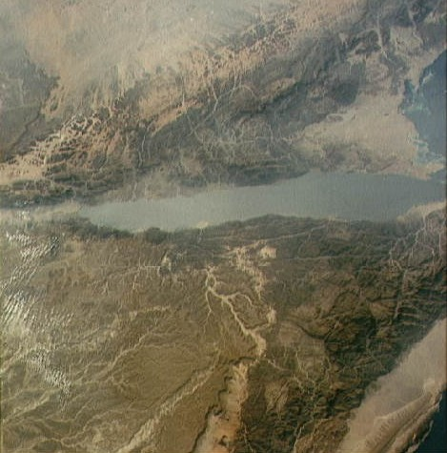
SINAI PENINSULA
Sinai Peninsula lies southeast of the Nile Delta.
Major crossroads between two continents-Africa and Asia.

Slide 8
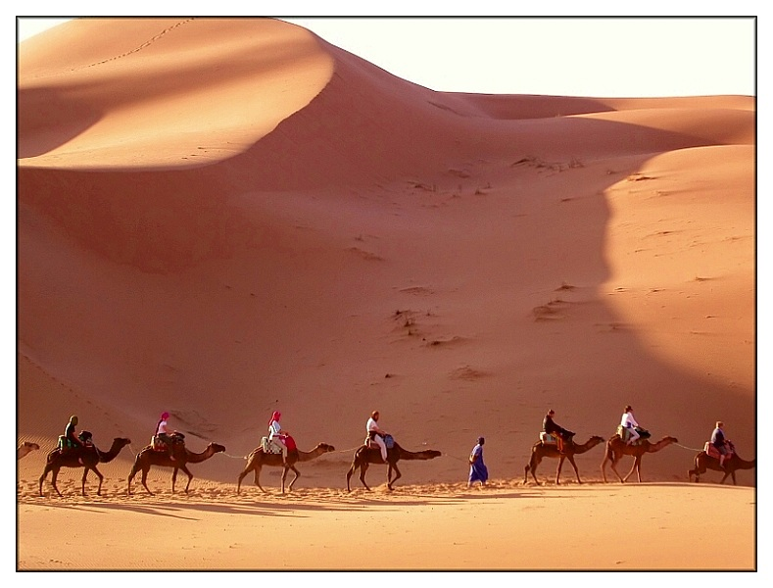
DESERTS aka Red Land
Most of Egypt is desert.
2 deserts occupy most of Egypt: Libyan and Arabian.
The Libyan desert covers two-thirds of Egypt’s land area.
The Libyan and Arabian deserts are parts of the Sahara desert, one of the largest deserts in the world.

Slide 9
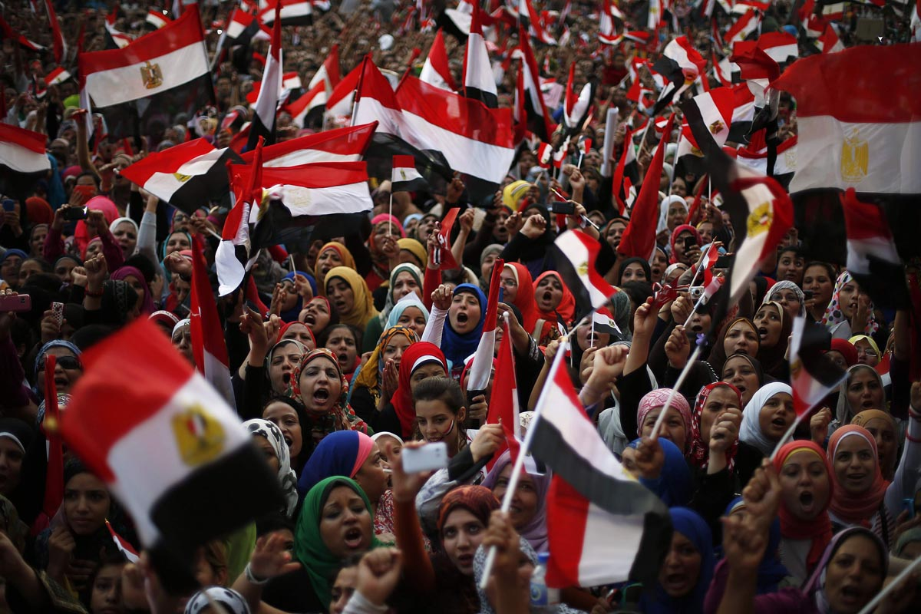
The Egyptian Revolution

Slide 10
http://www.youtube.com/watch?v=K0H69z4_tYY
http://www.youtube.com/watch?v=f7f229WjdDY
http://www.youtube.com/watch?v=EljdrOBxM8c

