Slide 1
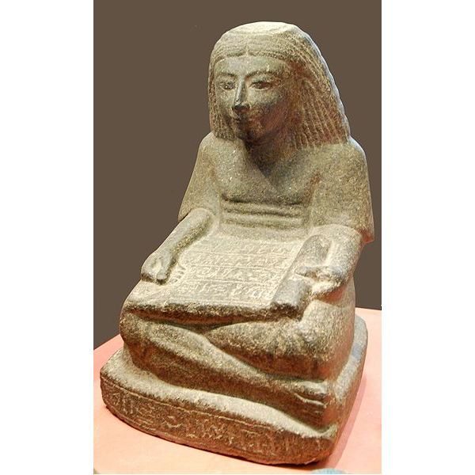
DEAR

Slide 2
Do Now 11.20.13
Think about one place that you have traveled. What did you bring back from this place? This could be an object (ex. T-Shirt) or an idea (a greater interest in something)

Slide 3
Identifying Hatshepsut
http://www.youtube.com/watch?v=s9jmZiy_T-c
Why would she make herself seem like a male?

Slide 4
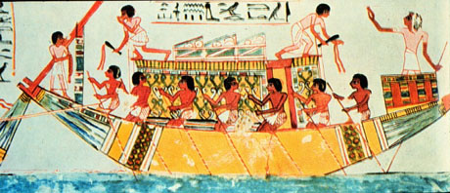
The Great Travelers
How did the culture and innovations of Egypt spread across the world?

Slide 5
It all begins with the Nile…
Egyptians innovate new _____________techniques
There is more farmland available and more ____is
created.
A ______ of crops is created, enabling people to do other jobs such as ________ and ____________.
Egyptians crops such as wheat, barley, and linen are traded to _____________in exchange for items used to build ships and create art.

Slide 6
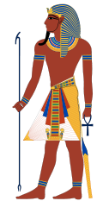
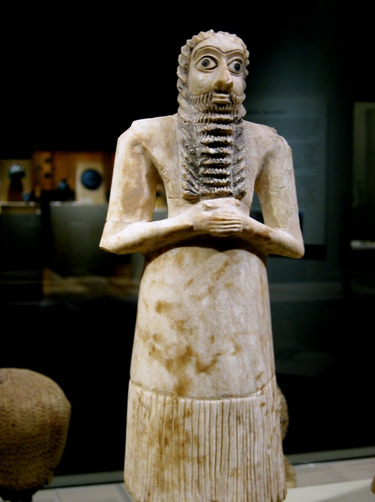
At first, trading occurred mainly between rulers. The pharaohs sent gifts of grain, pottery, dried fish, linen, and gold to rulers they wanted to impress or put in their debt. In return, those rulers sent gifts or payment of wood, livestock, and gems that were not found in Egypt.

Slide 7
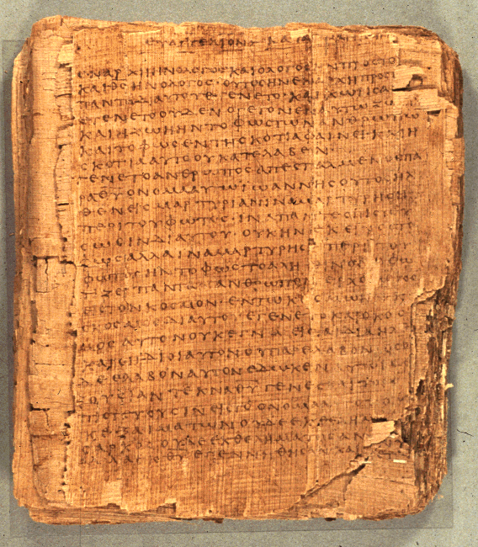
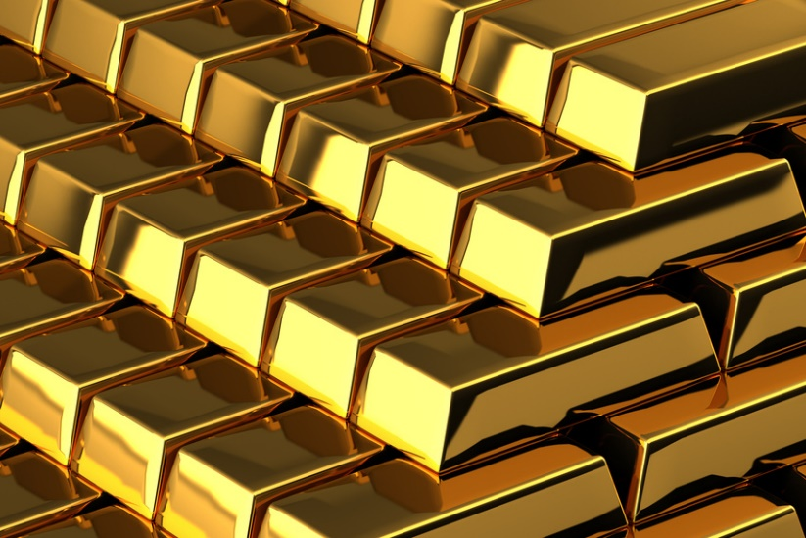
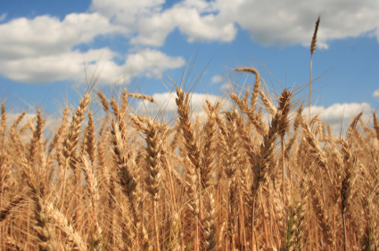
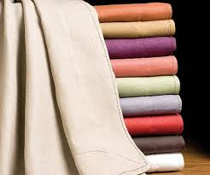
What they had:
AKA Exports
Gold
Grain
Papyrus
Linens

Slide 8
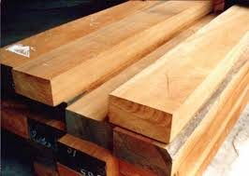
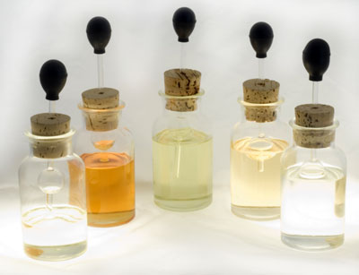
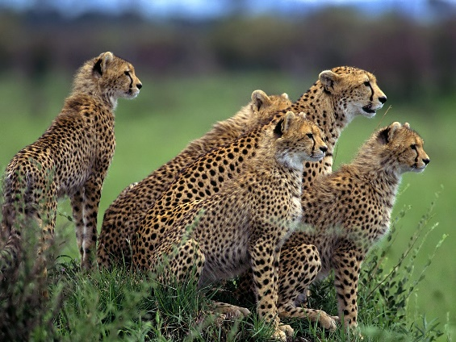
What they didn’t have and got elsewhere
Timber
Bronze
Iron
Ivory
Oil
Myrrh (used to perfume mummies)
Exotic Animals
AKA Imports

Slide 9
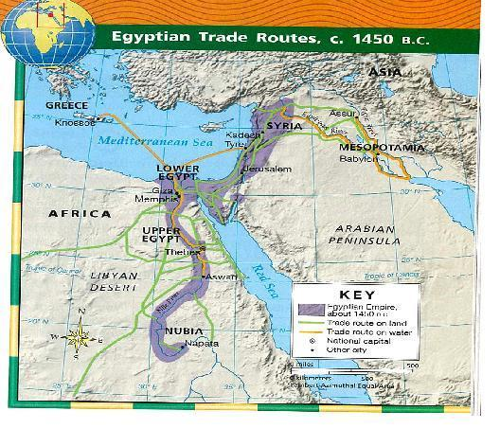

Slide 10
Hatshepsut’s Expedition to Punt.

Slide 11
Personal Ornamentation
Why did the Egyptians care so much about their appearances? Why do we care today?
http://app.discoveryeducation.com/techbook2:concept/view/guidConceptId/e656dae5-3130-4885-ad9d-c70eb6d7a448/guidUnitId/c2b3c0a5-8502-4687-a13f-a2fb95ba90dd#/tab=model-lesson-tab&page=1&subTab=de-resources-tab

Slide 12
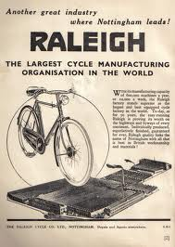
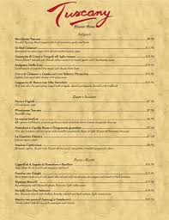
Your Activity – a choice!
Choice 1 | Choice 2
Create an advertisement for one of the exports of Egypt. You would want to sell this item to other civilizations. | Pick up the article The Land of Gold. Read the article and create a dinner menu using only the food grown in the Nile River Valley.

