Slide 1
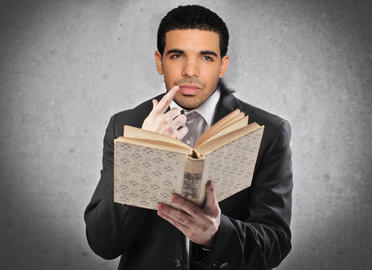
DEAR

Slide 2
Do Now 11.12.13
Why do humans need laws? How do laws help society?

Slide 3
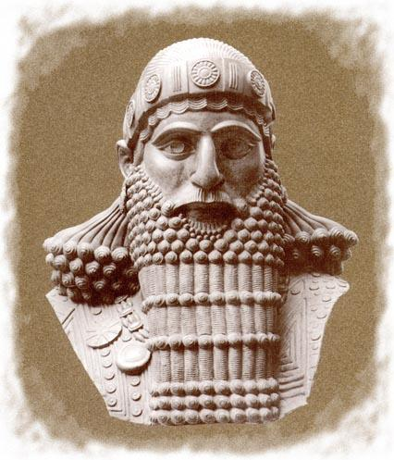
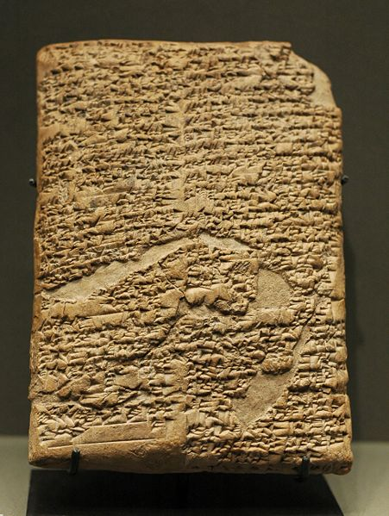
Thousands of years ago, Hammurabi ruled over a huge empire in the Middle East →
To keep his people unified, he developed the first written code of law→

Slide 4
Fair or Unfair?
Read the laws of Hammurabi and decide if the punishment is fair or unfair. If you believe it is fair, go to the side of the room labeled FAIR. If you believe the punishment is unfair, go to the side of the room labeled UNFAIR.

Slide 5
Hammurabi’s Code
If someone sets fire to a house, he shall be thrown into that same fire.
If a son strike his father, his hands shall be cut off.
If a man kills a pregnant woman, his daughter shall be put to death.
If a freed man strike the body of another freed man, he shall pay a fine.
If the slave of a freed man strike the body of a freed man, his ear shall be cut off.

Slide 6
Hammurabi’s Code
Distinguished between social classes
Ex: a freed man would get a less severe punishment than a slave
Rulers could not longer make random and unfair decisions
The punishment fit the crime

Slide 7
Within your journals, answer the following questions
What was the importance of Hammurabi’s Code of Law?
Why do civilizations need laws?
How did Hammurabi’s laws change Mesopotamian society?

Slide 8
Do Now 11.13.13
Why is it important that our laws be written down? What happens when people are not literate and cannot read the laws?

Slide 9
Hammurabi Today
With a neighbor, come up with a punishment you think Hammurabi use for these modern-day crimes
Don’t forget:
The punishment fits the crime!

Slide 10
1. A boy steals a bag of flaming hot cheetos from the grocery store.
2. A student curses at a teacher.
3. A woman purposefully breaks someone else’s cell phone.
4. A man who recently gets fired knocks out the windows of his boss’s car.
5. A student paints graffiti on the school bathroom wall.

Slide 11
Welcome to the court of Hammurabi…
Within your groups, you will receive a court case from ancient Mesopotamia. Your job is to use Hammurabi’s code to determine whether the defendant is guilty or innocent. The four laws are:
Law 196: If a man puts out the eye of another man of the same social class, his eye shall be put out.
Law 197: If a man breaks another noble man's bone, his bone shall be broken.
Law 198: If a nobleman puts out the eye of a commoner or slave or breaks the bone of a commoner or slave, he shall pay one piece of silver.
Law 199: If a slave puts out the eye of a nobleman or injures him in another way, he shall immediately be put to death.

