Slide 1
Do Now 11.19.13
Why were Egyptians mummified and buried with their most prized possessions?

Slide 2
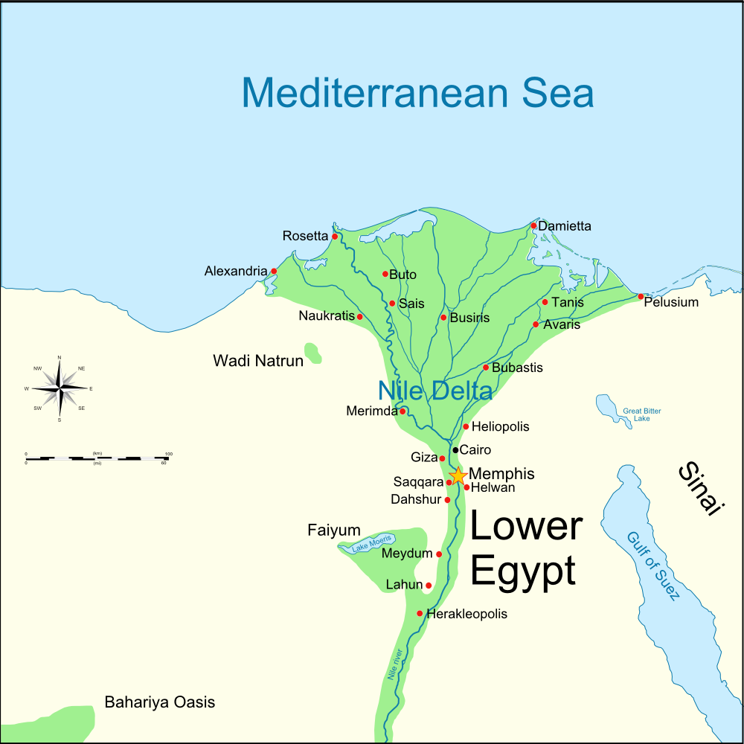
The Tale of Egypt
The early people who settled along the Nile River banded together into two main groups.
One group lived around the mouth of Nile River, near the Mediterranean Sea. Their king wore a Red Crown. Their land was called Lower Egypt.

Slide 3
The other group lived near the mountains to the South. Their king wore a White Crown. Their land was called Upper Egypt.

Slide 4
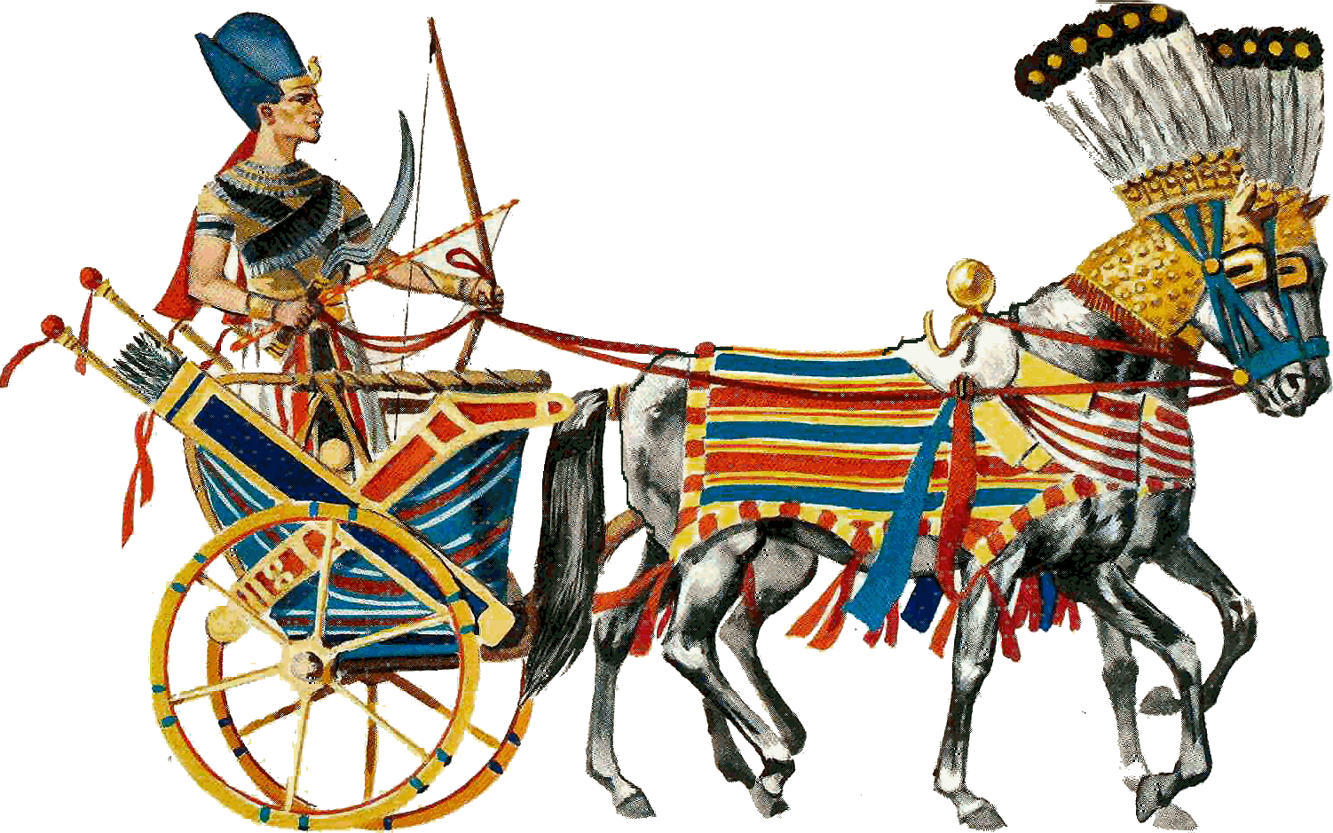
These two groups had much in common. They spoke the same language. They worshipped the same gods. They had the same culture. But, they did not get along. They were always fighting.

Slide 5
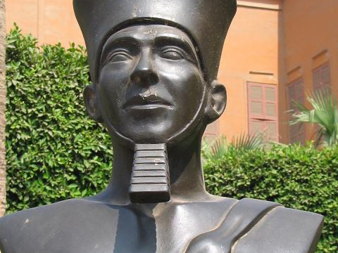
Around 3000 BCE, King Menes ruled Upper Egypt. He conquered Lower Egypt. These two groups continued to fight. One day, King Menes had an idea. Over time, The Two Lands became known as Egypt.

Slide 6
The Curse of King Tut’s Tomb
http://www.youtube.com/watch?v=6Xv8dCIWi6w

Slide 7
How it all began…
“Death shall come on swift wings to him that toucheth the tomb of Pharaoh.”
These are the words written across the seal of King Tut’s tomb in Egypt. When this tomb was disturbed for the first time in 3400 years by the English Egyptologist Howard Carter in November of 1922, newspapers around the world announced the discovery.

Slide 8
Wait, who was King Tut anyway?
Tutankhamun was an Egyptian king that is more famous for his death than for his life.
Tut began ruling when he was 8 years old, and died when he was 18.
Very few written documents on Tut survive and not very much is known of his life.
Most experts agree Tut died a violent death, but they don’t know for sure if he was murdered.
Tut is most famous because his spectacular tomb was discovered, almost intact and filled with treasures, by Howard Carter in 1922.

Slide 9
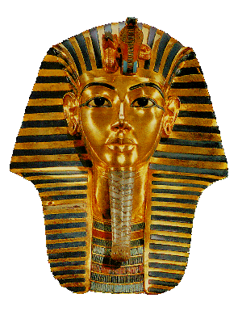
Here are some of those treasures! Nice, aren’t they?

Slide 10
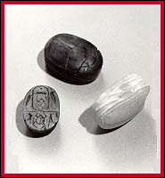
Why were the Egyptians so into pyramids and mummies?
The Egyptians were obsessed with the cult of the dead.
They had elaborate death rituals and gods.
To protect the dead in the afterlife and to prevent robbers from desecrating tombs, the Egyptians hid their burials and placed curses to warn off violators.

Slide 11
Who were Howard Carter and Lord Carnarvon?
Lord Carnarvon was a very wealthy man who paid Howard Carter to search for the tomb of King Tut in Egypt.
Howard Carter searched for the tomb for five years.
Their find became the most famous archaeological discovery of all time.

Slide 12
Here are some of the rumors and the facts associated with them…you be the judge!
i smell bird
On the same day that the entrance to the tomb was laid open, Carter’s pet canary was eaten by a cobra. Cobras are very rare in Egypt and especially so in winter. In ancient times they were regarded as the symbol of royalty.
Carter did have a canary, but he gave it to a friend to keep. No one knows for sure about the cobra.
Most of the Egyptian workers who were present when the tomb was opened died within a year.
6 out of the 26 workers were dead within 10 years.

Slide 13
Still more strange happenings…and these are all facts.
Lord Carnarvon and archaeologist Howard Carter entered the king's burial chamber on February 17, 1923. On or about March 6, Lord Carnarvon was bitten by a mosquito on his cheek and became ill.
The mosquito bite became infected, he contracted pneumonia and blood poisoning, and on April 5, he died.
The bite was in the same spot on his cheek as a scar found on the mummy of Tut.
At the same time Carnarvon died, all the electricity in Cairo went off. In fact, the lights in the hospital went off almost to the second when he died.
At the same hour Carnarvon died, Carnarvon’s pet terrier, Susie, howled and dropped over, dead.

Slide 14
So what do you think?
What do you think happened to Howard Carter?
What do you think would be a possible explanation for the deaths of the workers in the tomb?
What do you think people would say if a similar discovery happened today and the newspapers said the tomb had a curse?

