Slide 1
Do Now 11.18.13 Identify and describe a religion that is different than your own.
Materials: Notebook and SWAG pass

Slide 2
DEAR

Slide 3
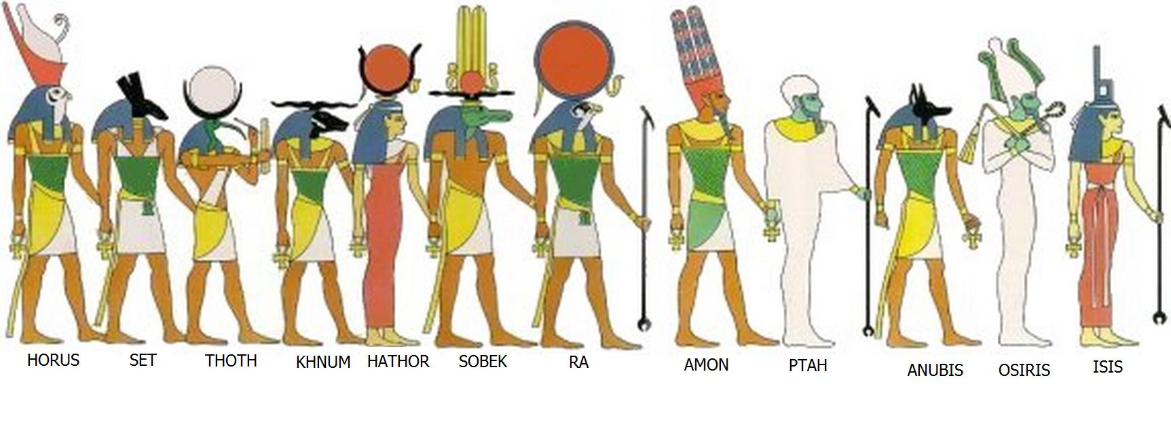
Egyptian Religion
The ancient Egyptians had over 2,000 gods! Egyptians believed that at one time the gods had been alive and ruled Egypt. So naturally Egyptians wanted to stay in the gods’ good favor. The Pharaoh was thought to be the only living god left, and he spoke for all the gods, which meant his word was law. He was the leader of the gods and the government.

Slide 4
Let me introduce you to a few…
Osiris
Osiris was the god of death, rebirth, and the Underworld
Anubis
Anubis was the jackal headed god of mummification and the god of the dead.

Slide 5
This is Ra, the god of the Sun and the most important God to the Egyptians
Isis is the goddess of motherhood and children

Slide 6
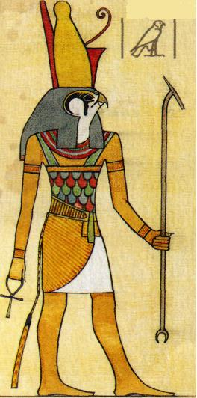
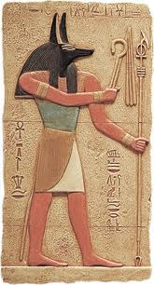
Often, these Gods took the form of a human or animal, or sometimes both.

Slide 7
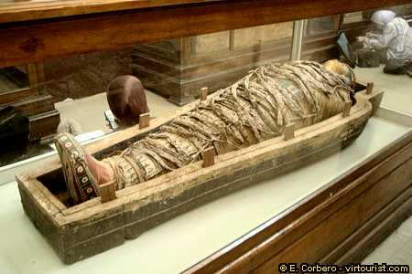
So what about these mummies?

Slide 8
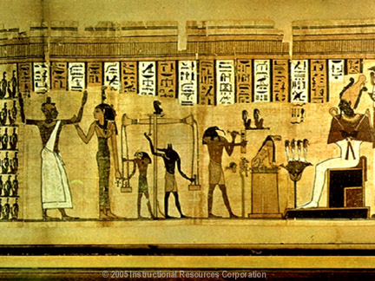
Afterlife
Ancient Egyptians believed that their souls would continue to live in the underworld after their bodies had died. For this reason, most Egyptians wanted to be buried near their relatives and friends. They also were buried with prized possessions, such as jewelry, so that they could have them in the afterlife.

Slide 9
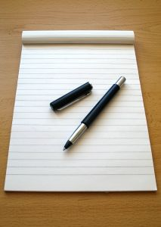
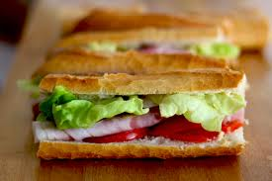
Turn and Talk
What three possessions would you want available to you in the afterlife?

Slide 10
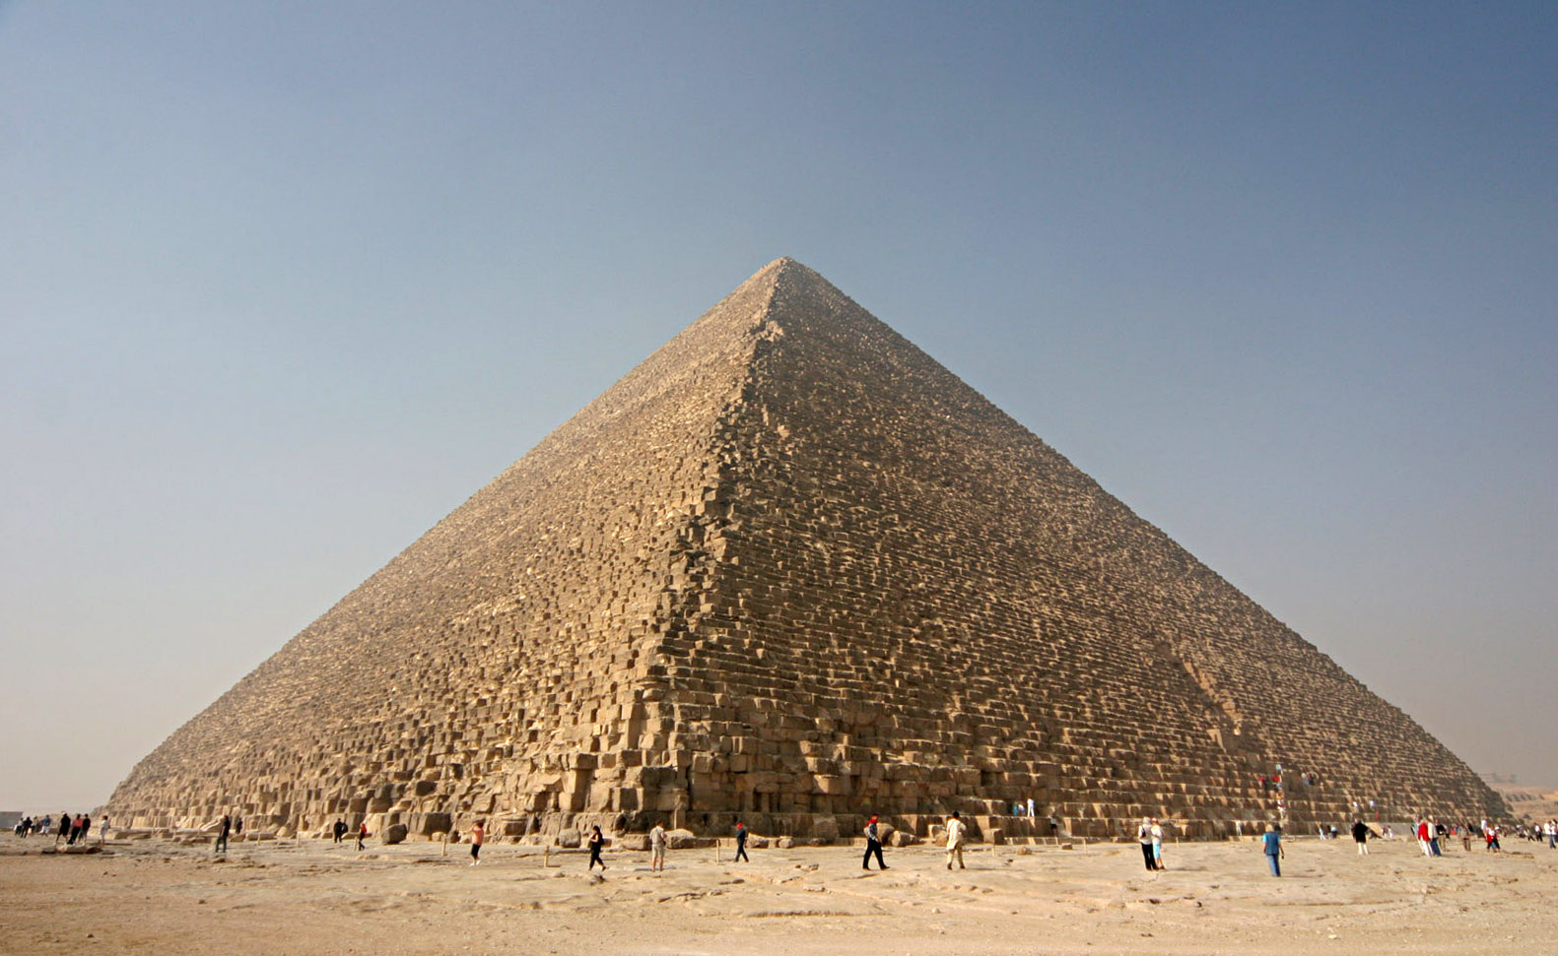
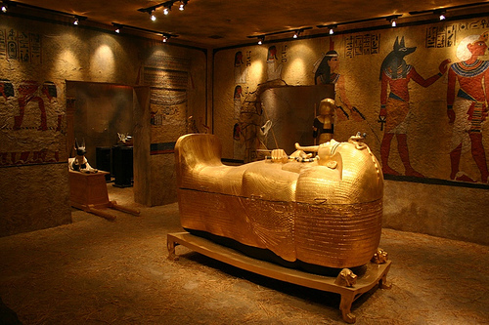
Ancient Pyramids
Just as pharaohs always had the finest things in life, the rulers of Egypt brought the finest things with them into the afterlife. Pharaohs were buried in elaborate tombs. Some, like Khufu’s Great Pyramid at Giza, were large so that all could see them. Others, like King Tutankhamen’s tomb, were a series of maze-like rooms cut into cliffs so that thieves would not be able to find them. These tombs took years to build, so work on a pharaoh’s tomb often began long before a pharaoh took the throne.

Slide 11
Mummification
The best way the ancient Egyptians knew how to preserve a body was to mummify it. The poor placed the bodies of their dead relatives out in the sun, in the desert sand. The bodies mummified naturally.
Anyone who could afford it went to a professional mummy maker. People wanted to look their best in their afterlife.
http://www.youtube.com/watch?v=-MQ5dL9cQX0

Slide 12
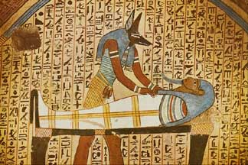
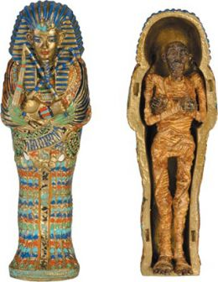
Why do this to their dead?
Ancient Egyptians believed in life after death. They believed that if they preserved the body, a person could use it in the afterlife.

